Slide 1
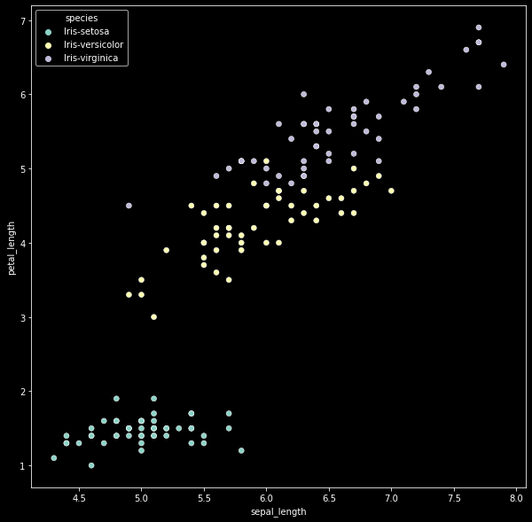
Support Vector Machine
The objective of the support vector machine algorithm is to find a hyperplane
in an N-dimensional space(N — the number of features) that distinctly classifies the data points.

Slide 2
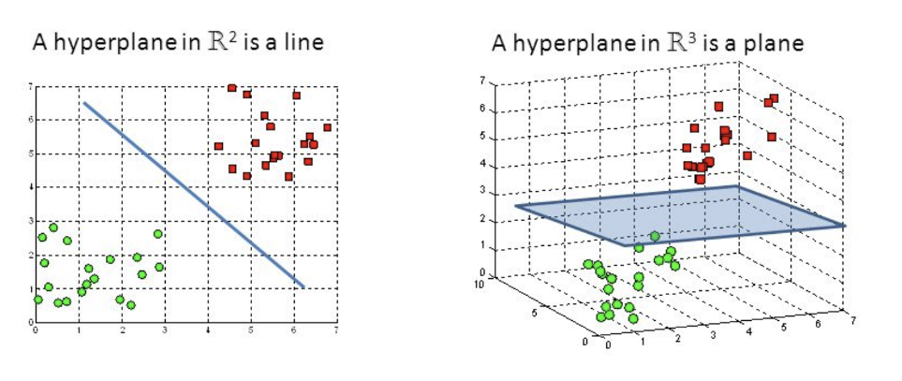

Slide 3
Important Terms
Kernel - SVM algorithms use a set of mathematical functions that are defined as the kernel.
The function of kernel is to take data as input and transform
it into the required form. For example linear, nonlinear, polynomial, radial basis function (RBF),
and sigmoid.
from sklearn.svm import SVC
model = SVC(kernel='linear')
# fitting x samples and y classes
model.fit(x_train, y_train)

Slide 4
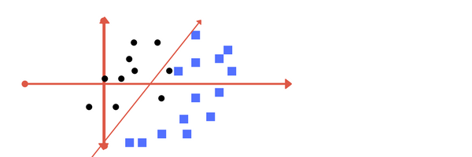
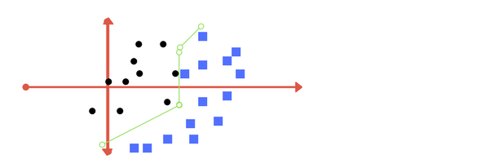
2. The Regularization parameter (often termed as C parameter in python’s sklearn library) tells the
SVM optimization how much you want to avoid misclassifying each training example.
Low Regularisation
High Regularisation

Slide 5
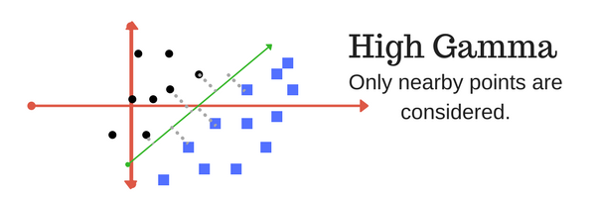
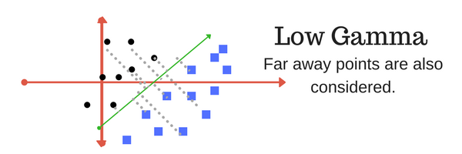
3. The gamma parameter defines how far the influence of a single training example reaches,
with low values meaning ‘far’ and high values meaning ‘close’. In other words, with low gamma,
points far away from plausible separation line are considered in calculation for the seperation line.
Where as high gamma means the points close to plausible line are considered in calculation

